Slide 1

Fiction Profile Project Overview & ER Diagram Presentation

Slide 2


Meet Our Team
Shah Mohammad Abdul Mannan
ID: 2105056
Dipit Saha
ID: 2105050

Slide 3
Project Overview
Our project, titled "Fiction Profile," is a dynamic platform designed for users to engage with diverse media content including books, fiction, series, and movies. It offers a vast user experience allowing interaction based on preferences in Cast, Rating, Language, and Genre. Users can access content using Favorite Content ID, Language, and Title parameters, ensuring seamless content exploration.
The platform also supports complex queries, empowering users to filter fiction by genre, sort by ratings, and easily identify creator IDs, enhancing the depth of user engagement.

Slide 4
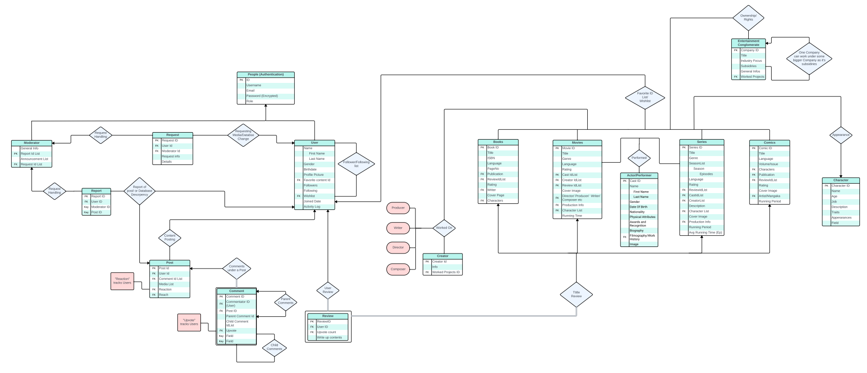
ER Diagram
PDF Here

Slide 5
One-to-One Relationships
Request, Review, Post, Report, Comment to User
User-Request, Report to Admin
Review to Books, Movies, Series
Comment to Post
Book/Series/Movie to User

Slide 6
One-to-Many Relationships
User, Post to Comment
Books, Movies, Series to Ratings, Reviews
User to Request, Review, Post, Report, Comment
User to favorites (Books, Movies, Series)

Slide 7
Many-to-Many Relationships
User to User through Followers, Following
Content to Content through Genre, Language, Ratings, Cast, Creator
Content to Cast
Content to Creator

Slide 8

Entity Sets

Slide 9
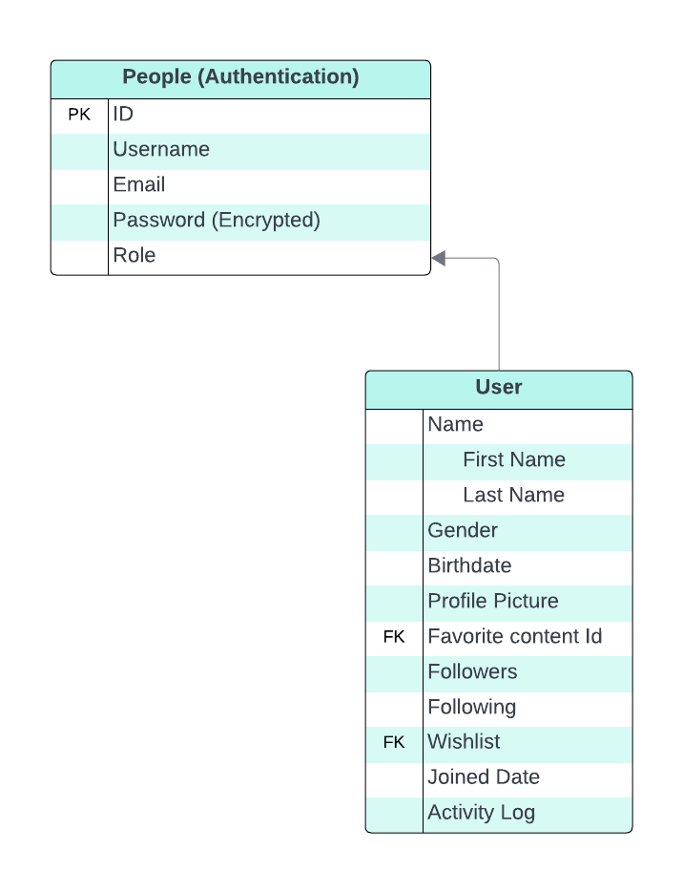
User Entity
Represents individuals registered within the platform.
Contains essential details like UserID, Username, Email, and Password.
Facilitates user authentication and personalization.
Enables social interactions, content preferences, and engagement.

Slide 10
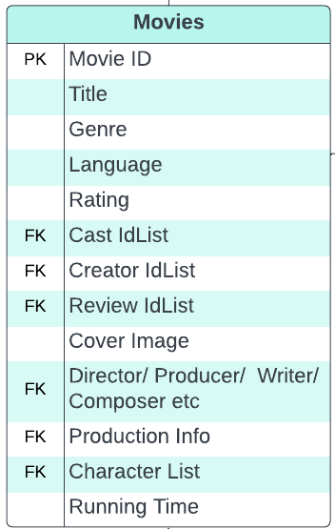
Movies Entity Set
The Movie entity set encompasses key details and attributes related to films. It includes fields such as Movie ID, Title, Genre, Release Date, Director, Cast, Rating, Language, and Description.
These attributes encapsulate essential information about each movie, including its genre, release details, notable cast and crew, viewer ratings, and a brief overview of the movie's plot or theme.

Slide 11
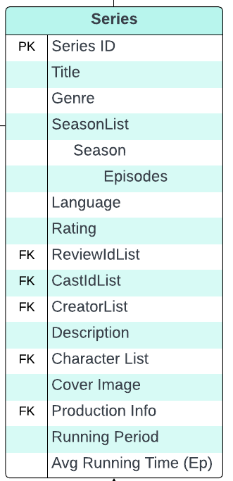
Series Entity Set
The Series entity set represents serialized content, typically TV series or shows. It comprises attributes such as Series ID, Title, Genre, Release Date, Director, Cast, Rating, Language, and Description.
Similar to movies, these attributes offer crucial details about TV series, including their genre, release specifics, directorial information, cast members, audience ratings, and a brief summary of the series' premise or storyline.

Slide 12
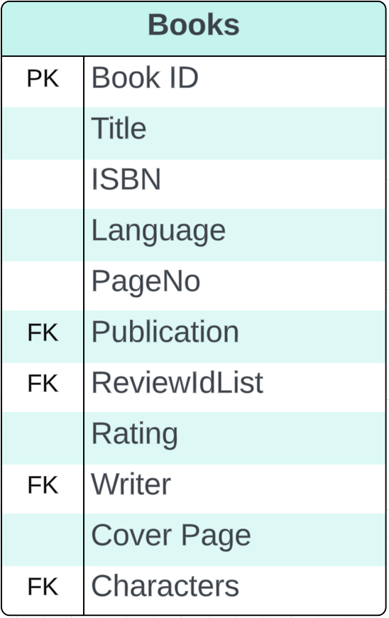
Book Entity Set
Represents individual books within the platform.
Attributes include BookID, Title, Author, Genre, Publication Date, Language, and Description.
Stores vital book details like author information, genre categorization, publication specifics, and a brief overview of the book's content.
Enables users to explore, engage with, and review books based on diverse preferences.

Slide 13
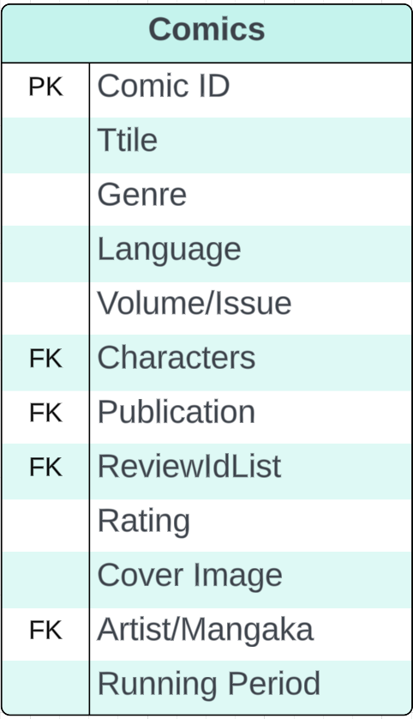
Comics Entity Set
Represents comic books or graphic novels in the database.
Attributes include ComicID, Title, Artist/Writer, Genre, Release Date, Language, and Synopsis.
Stores details such as artist/writer information, genre classification, release specifics, and a brief summary of the comic's storyline.
Facilitates user exploration, interaction, and review of comics based on varied preferences.

Slide 14
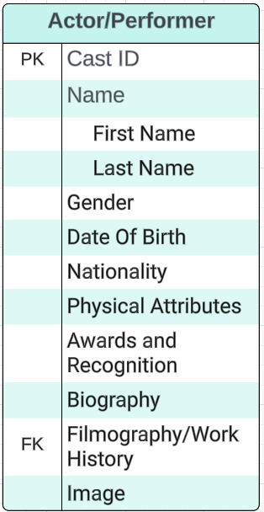
Actor/Performer Entity Set
Represents individuals involved in performances.
Attributes: ActorID, Name, Date of Birth, Nationality, Bio.
Stores details such as birthdate, nationality, and a brief biography of the performer.
Links performers to movies, series, or other productions for association and categorization purposes.

Slide 15
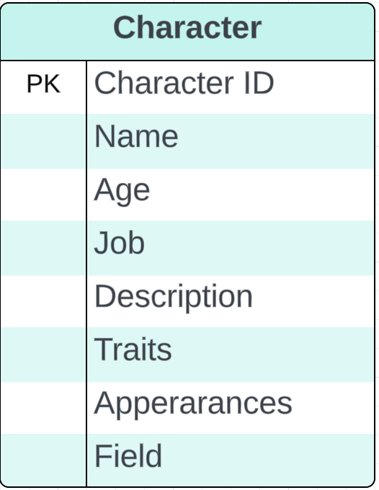
Character Entity Set
Represents personas or roles within media content.
Attributes: CharacterID, Name, Description, Origin.
Contains details like character names, descriptions, and origins.
Associates characters with specific books, movies, series, or comics for identification and categorization purposes.

Slide 16
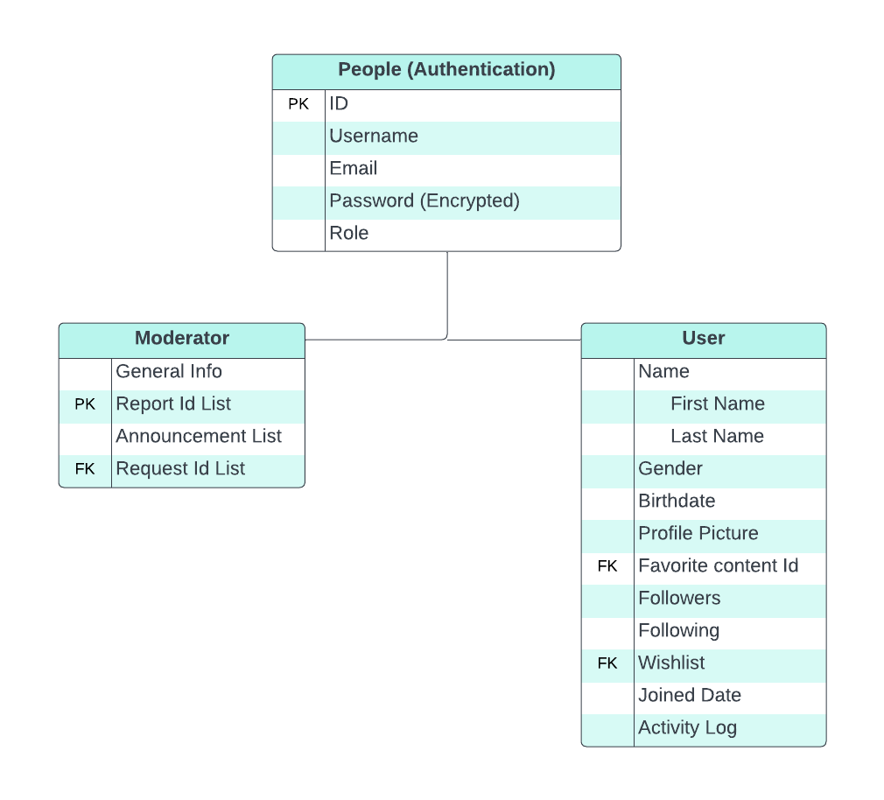
Authentication Process
Incorporates a generalization relationship for user access, where individuals signing in are classified into two distinct roles: "Users" and "Moderators," based on their provided username and password credentials.
This hierarchical structure ensures that users enjoy personalized interactions with their preferred content, while moderators, equipped with additional privileges, can effectively manage requests, reports, and content moderation

Slide 17

User Interaction:
- Users can engage with books, fiction, series, and movies based on Cast, Rating, Language, and Genre preferences. - Access to items is facilitated via Favorite Content ID, Language, and Title, allowing for versatile access to content. - Complex queries are supported, enabling users to filter fiction by genre, then further sort by ratings and identify the creator ID.

Slide 18
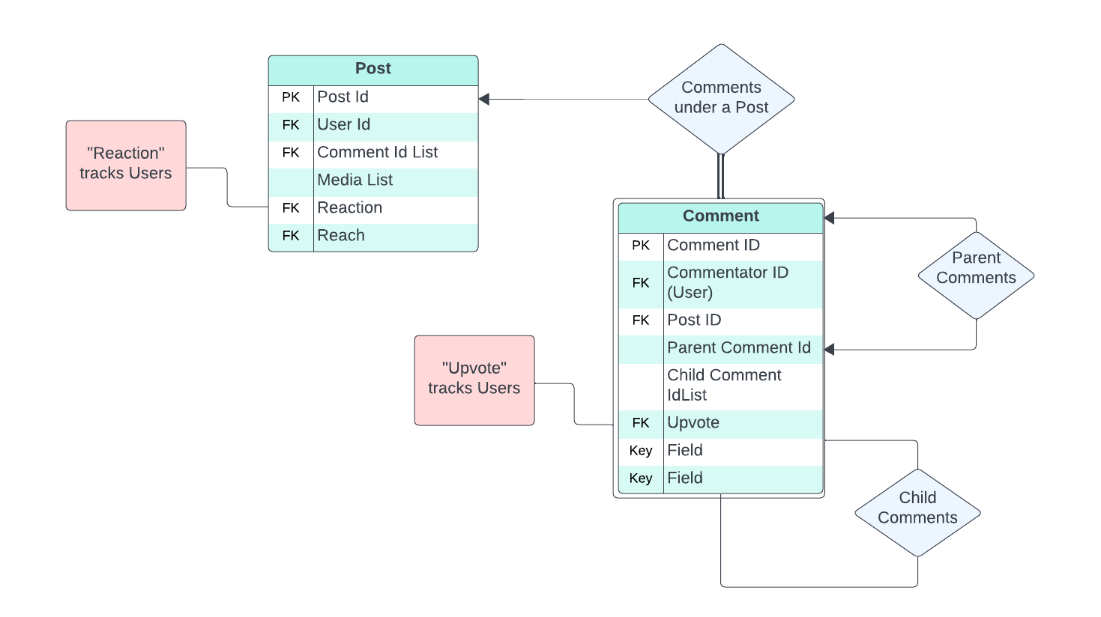

Post - Comments
Facilitates user engagement by allowing individuals to create posts and share their thoughts on various content.
The relational structure ensures that users can view and comment on posts, with the added capability of nesting comments in a graphical structure.
Promotes interactive discussions and a dynamic community experience.

Slide 19
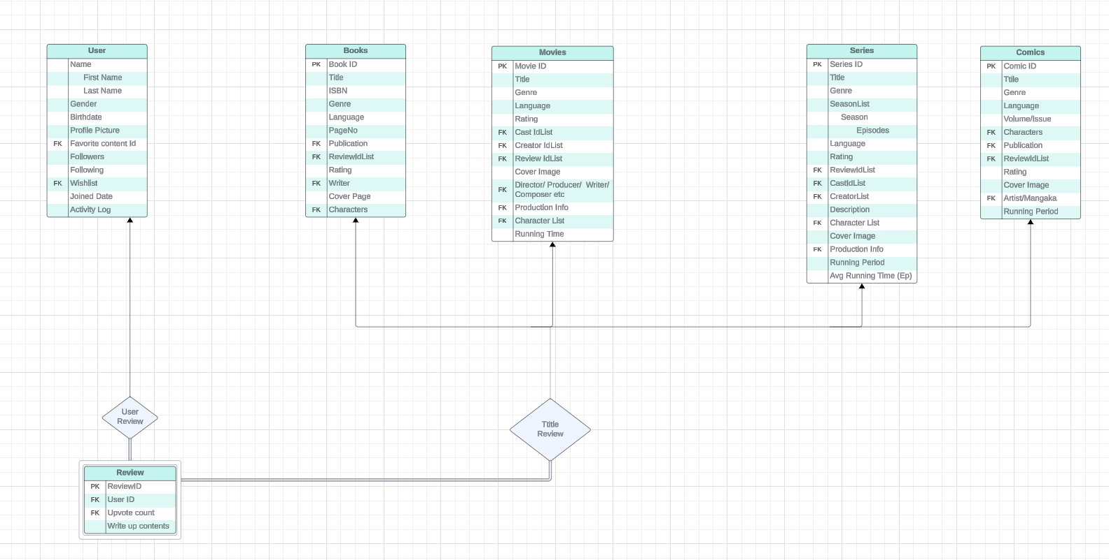
Review/Ratings
The "Review, Ratings" relationship among all fictions in various media types, including movies, comics, books, and series allows users to contribute reviews and ratings across diverse content. Users have the flexibility to express their opinions on movies, series, books, and comics, contributing to a comprehensive and collective evaluation system.

Slide 20
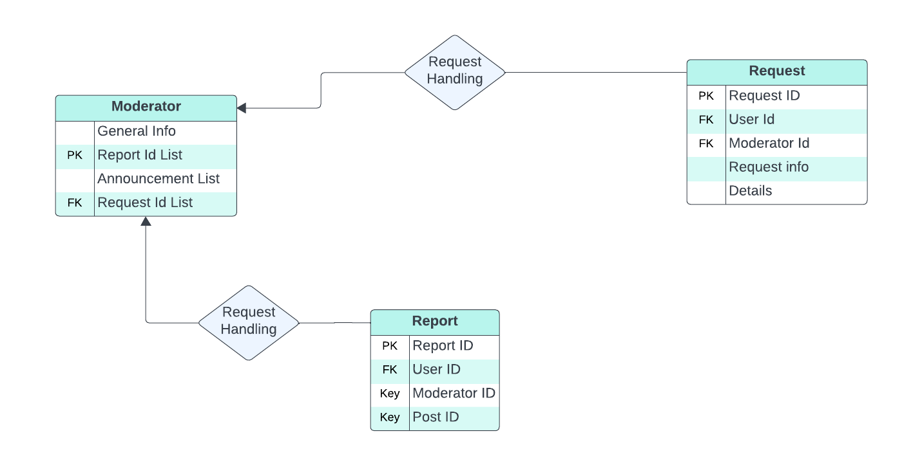
Moderator- Request/Report Handling
Plays a crucial role in managing user interactions. This entity establishes relationships with both the "User" and "Fiction" entities, allowing moderators to efficiently handle user-generated requests and reports related to various functions on the platform.

Slide 21
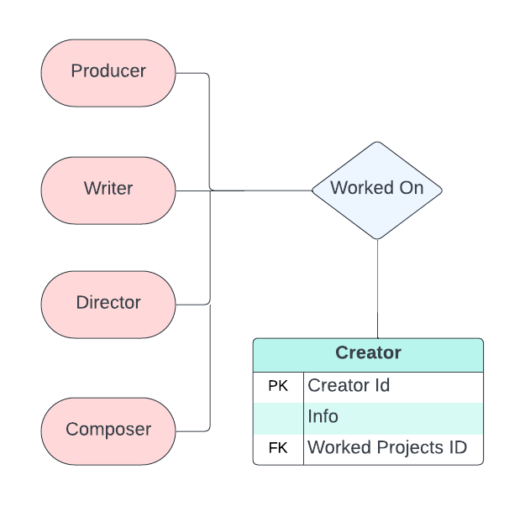
Creator
This entity establishes connections with various fictions, linking creators to the content they have contributed to.
Users can utilize the global search functionality to explore and search for creators, facilitating easy access to a creator's body of work across movies, series, books, and comics.

Slide 22
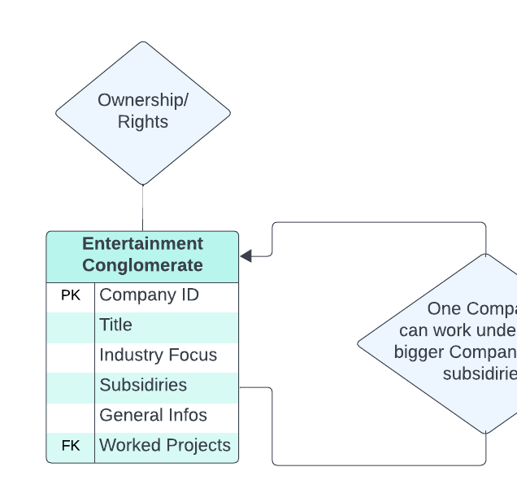
Production/Publication Company
Represents content-producing or publishing entities.
Contains attributes: CompanyID, Title, Type, Description.
Links media content to respective production/publishing sources for categorization and exploration.

Slide 23
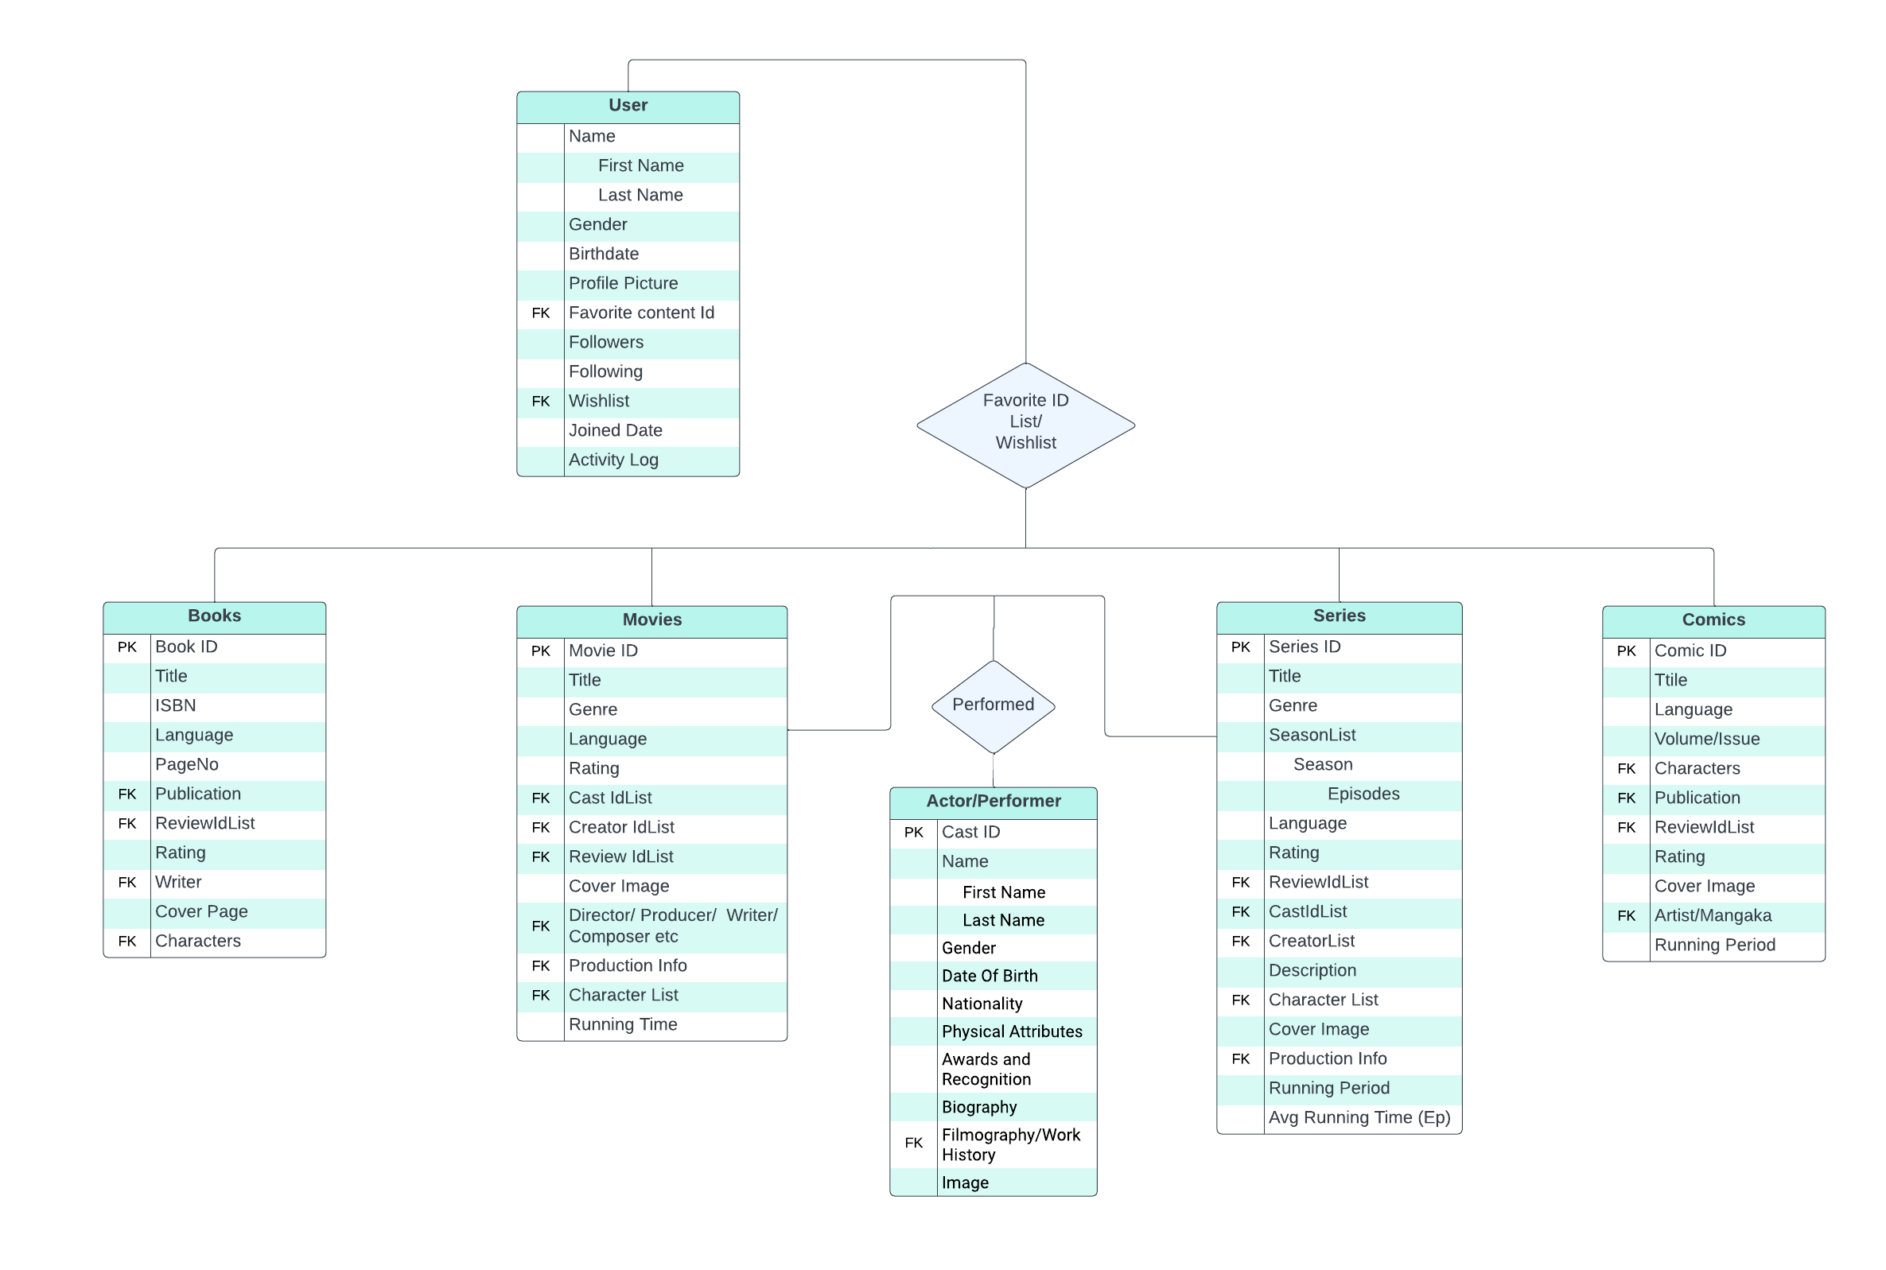
Wishlist and Favourite Content
Facilitates the favorite list also maintains user wish list accordingly.

Slide 24
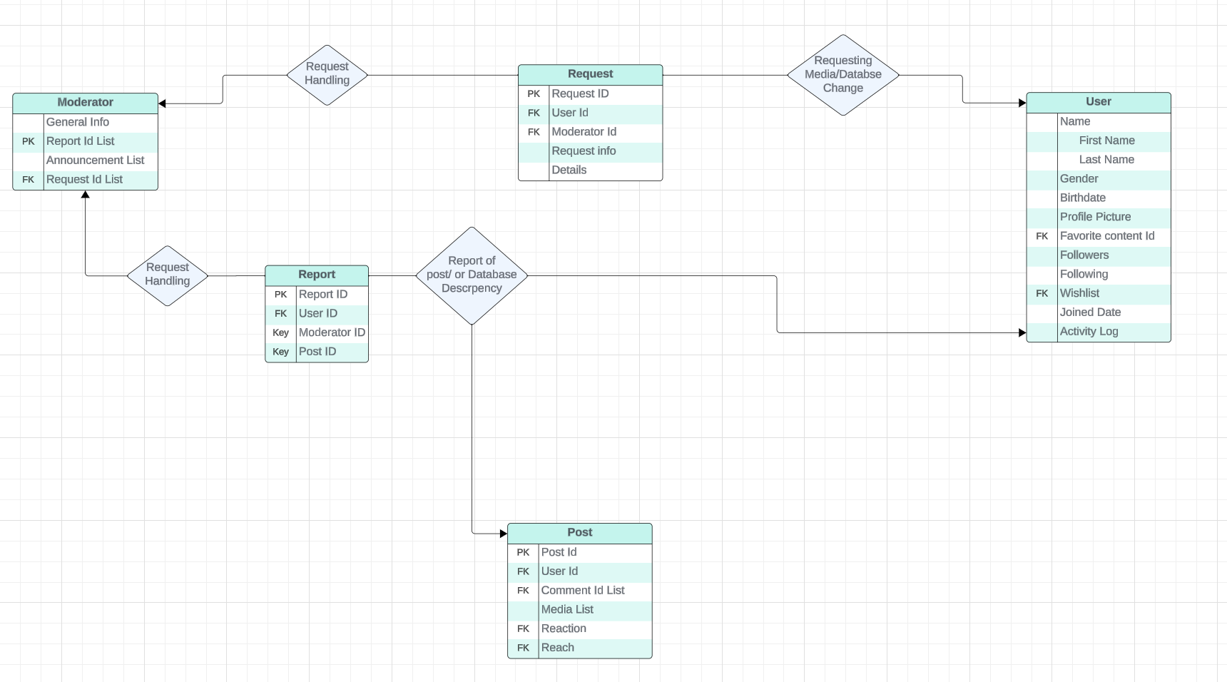
User Reporting, Requesting and Admin Actions:
- Users have the option to request and report content, directing it to the admin. - Admin can accept and modify requests using queries for efficient content management.

Slide 25
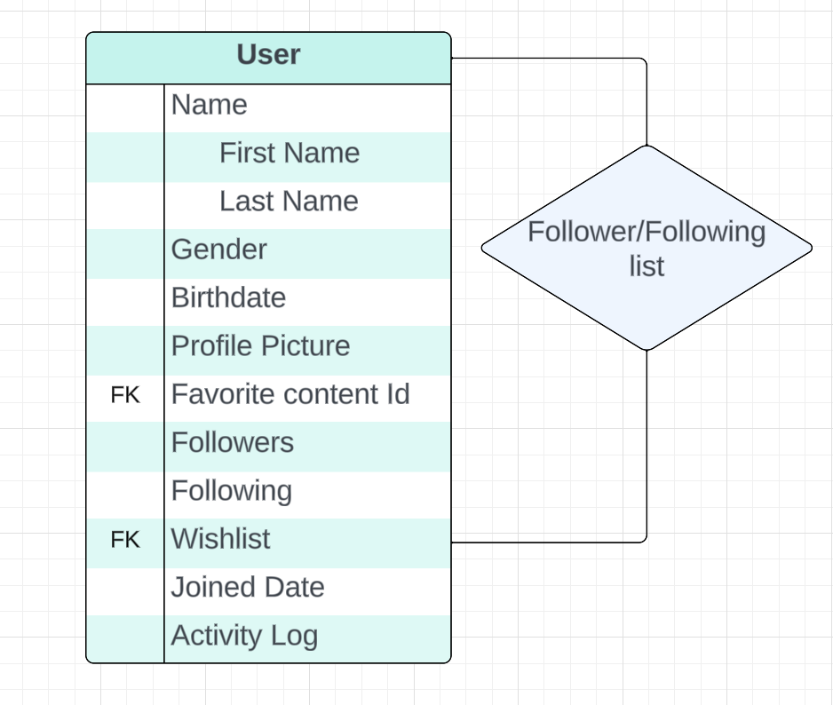
Followers/Following
The "Followers" and "Following" attributes in the User table establish a one-to-many relationship, fostering a social interaction dynamic.
Users can follow others, creating a connection that enhances their experience by allowing them to engage with and explore the preferred content of those they follow.
This relational structure facilitates a user-friendly environment for content discovery and interaction within the Fiction Profile platform.

Slide 26

Common Attributes:
The common attributes shared among series, fiction, movies, and books in the Fiction Profile database provide a standardized framework for organizing and presenting diverse content.
Elements such as cast, genre, rating, and language serve as universal data points, ensuring a consistent and coherent structure across various types of content.
This standardization not only simplifies database management but also enhances the user experience by providing a familiar and easily navigable interface for exploring and accessing different forms of entertainment on the platform.

Slide 27

Thank You

